Slide 1
Presentation on the
Automated Purchase GSTR2A/GSTR2B Reconciliation Tool
Contact :
GM Tech Analytics
support@gmtechanalytics.com
https://gmtechanalytics.com
+91-86104 39343 / +91-86083 36352

Slide 2
About the Automated Purchase GSTR2A/GSTR2B Reconciliation tool
The automated Excel based Purchase GSTR2A/GSTR2B Reconciliation Tool is an extremely
powerful tool that will reconcile the user’s purchase book with GSTR2A/GSTR2B returns
completely , listing out matched and unmatched invoices both Invoice-wise and vendor-wise.
The main USP of this Tool is that raw purchase data generated from any ERP/accounting
software as well as GSTR2A/GSTR2B data can be imported directly into the tool without any
formatting whatsoever (removal of headers, removal of blank rows, re-alignment columns etc).
Reconciliation will take place in a matter of seconds automatically once data from purchase
book and GSTR2A/GSTR2B is imported into the Tool.
The Tool runs extremely fast (for instance, reconciliation of a company's data with nearly 10,000 rows of data that might otherwise take at least 3 hours to complete manually can be completed in under a minute).
The Tool consumes miniscule hard disk space(File size is under 125 KB). As the tool is an Excel file , no special installation procedures are required.

Slide 3
Tool layout
Layout of the tool
Automated Purchase GSTR2A/GSTR2B
Reconciliation Tool
Help
Master
RawData_GSTR2A2B
Master_GSTR2A2B_New Format
RawData_Books

Slide 4
Unique features of this tool
A very unique feature in this tool is the mapping functionality for columns in the purchase book , shown to the right, which does away with the need to manually re-format the user’s purchase book before importing it into the tool. Assuming a user’s raw purchase book has data for Vendor GSTIN in Column 1, Vendor Name in Column 2, Invoice Date in Column 4, Invoice Number in Column 5 and Total Invoice Amount in Column 6, with tax columns ( CGST SGST IGST and others in column 10, 11, 12 and 14 respectively ). In the given scenario, all the user needs to do before importing the purchase book (import functionality is again automated ) is enter the column numbers where the data for Vendor GSTIN, Vendor Name etc, are located in their Purchase book, against the respective fields in the mapping table in the tool (shown here) ,without needing to realign their Purchase book.
In case the purchase book changes form due to some reason in the future (columns swapping places , for ex: Invoice Date moving to Column 3 , GSTIN moving to Column 5 , and so on ) , the user just needs to re-enter the revised column numbers in the given mapping table in the tool before running the reconciliation. The algorithm in the tool will detect the appropriate columns based on the column numbers entered in the mapping table.
It is also possible to increase or decrease the number of columns for tax as it is observed for companies operating in certain industries that the tax columns are split into individual rates .For instance, CGST@2.5%, CGST@3%,CGST@6% and so on. In such a case , the User will enter the additional columns required in the adjacent field and invoke “Add” command button.

Slide 5
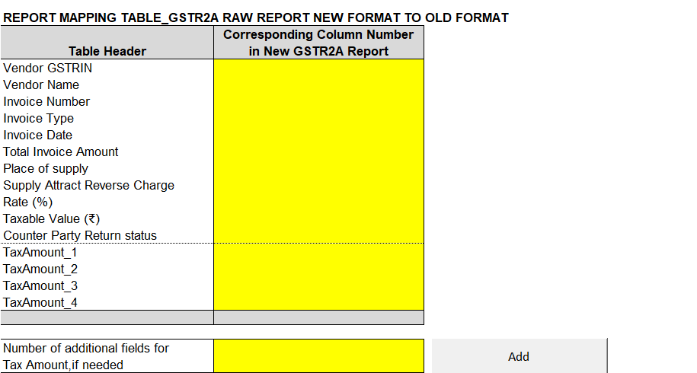
Unique features of this tool
In the same manner, a report mapping table is available for importing GSTR2A/2B data. This feature will be extremely useful in the event the data-columns in the GSTR2A/2B raw-reports (downloaded from GSTIN portal) change position from the existing layout (refer existing layout of raw GSTR2A report at the bottom).
Layout of existing GSTR2A raw report (downloaded from GSTIN portal)

Slide 6
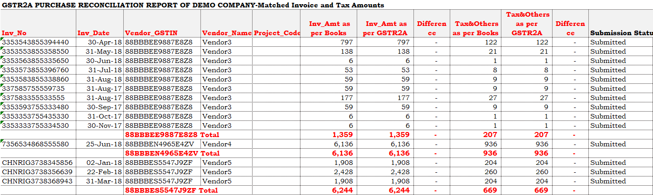
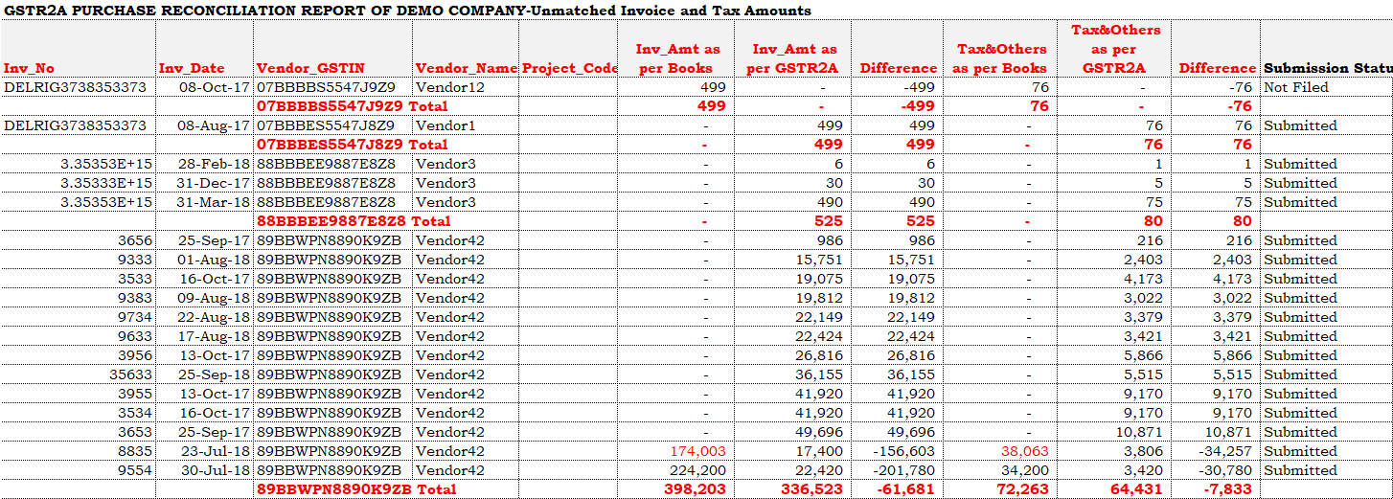
Tool output
The reconciliation report generated by the tool consists of two reports, RecoSheet_MatchedInvoices and RecoSheet_UnmatchedInvoices. While the former lists out all the matched invoices, the latter lists all the unmatched invoices ( refer screen-grabs of both the reports below)
Report extract - matched invoices
Report extract - unmatched invoices

Slide 7
Customers
The Purchase GSTR2A/2B Reconciliation Tool is being used by SMEs, CA firms and major MNCs, including:
Redington India Ltd
Tamil Nadu PetroProducts Ltd
IM Gears India (P) Ltd
Super Auto Forge (P) Ltd
CVG Seating Systems India (P) Ltd
Craftsman Automation Ltd
YSA Automotive (P) Ltd
Pung-Hwa India (P) Ltd
Dynamatics India Ltd
MB Metallic Bellows (P) Ltd
Arihant Duraplast (P) Ltd, among others.

Slide 8
Pricing
Pricing | One-time fee of INR 6,000
No. of installations | Two systems
License validity | Permanent

Slide 9
Contact and other details
For buying a permanent license of the tool, please reach out to us by email at support@gmtechanalytics.com or call us at +91-86104 39343 / +91-86083 36352.
Contact :
GM Tech Analytics
support@gmtechanalytics.com
https://gmtechanalytics.com
+91-86104 39343 / +91-86083 36352

