Slide 1
USER GUIDE
BUDGET AND FINANCIAL ANALYSIS TOOL

Slide 2
About the tool
The automated Budget and Financial Analysis Tool is an extremely powerful fully automated financial tool for budgeting, short-term and long-term cash flow simulation, P&L variance analysis, business valuation etc., and is one of the most accurate and advanced tools of its kind in the world.
The tool is developed in a manner that eliminates the need for customization. It is programmed to give budgeting/forecasting reports/variance reports for businesses engaged in varied activities without the need to manually build logic / functions / inter-link reports.
An user can prepare a comprehensive budget/forecast/simulation report for any type of business, be it manufacturing, trading, project-based services, subscription-based services etc and doesn’t need to have any financial/accounting knowledge to use this tool.
The tool is Excel-based and hence, can run on any computer with MS-Office.

Slide 3
About the tool
The tool can be used for :
Preparing long-term budgets and business plans
Generating short-term forecasts
Accurate cash flow planning
Carrying out project appraisals
Determining project break-even point
Determining business valuation
Performing automated detailed P&L variance analysis

Slide 4
About the tool
The tool has one input sheet where all the user inputs are entered. Only the yellow-coloured cells in the Input sheet are editable, with all other cells completely protected from editing.
The tool has the following reports :
Projected Monthly and Yearly Income Statements
Projected Monthly and Yearly Cash Flow Statements in both direct and indirect methods
Projected Monthly and Yearly Balance Sheets
IRR, NPV & Project valuation reports
Detailed Ratio analysis
P&L variance analysis report
Charts

Slide 5
Layout of the Tool
Budget and Financial Analysis Tool
Input Sheet
All user-inputs are to be entered in the Input Sheet
Reports
The reports will be auto-populated based on user-inputs in the Input sheet
Income Stmt_Mthly
IRR ,NPV & Ratio Analysis
Income Stmt_Yearly
Cash Flow Stmt_Mthly
Cash Flow Stmt_Yearly
Balance Sheet_Mthly
Balance Sheet_Yearly
P&L Variance analysis
Charts

Slide 6
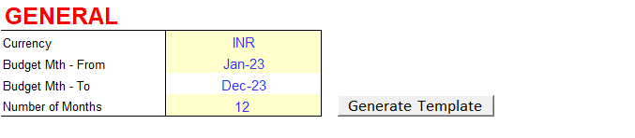
Input Sheet_General segment
The Input Sheet is divided into various segments like General, Equity, Borrowings, Revenue, Direct Costs, Operating Costs, CAPEX etc, with each segment highlighted in bold red fonts.
In the GENERAL segment, the user shall enter the following details :
Currency
Budget/Forecast beginning month
Number of months for which the budget/forecast is to be prepared (the user shall initially generate for only 12 months; after entering all the inputs in the Input sheet, as a final step, the user shall re-generate the template for the required period, say 48 months, 60 months etc. The tool will work much faster in this manner)
The user shall then click on the Generate Template button and thereupon, the tool will create the reports for the required period.
IMPORTANT !
Prior to entering the business-related inputs in the Input sheet (refer the subsequent slides), the user may generate the report templates for a short period, say 12 months, since the tool will work much faster in this manner. After entering all the inputs in the Input sheet, the user may finally generate the reports for the period required by them (say 60 months, 84 months etc).

Slide 7

Input Sheet_Equity segment
In the EQUITY segment, the user shall enter the months when equity is to be planned to be brought into or taken out of the business, along with the equity amounts for each of those months. The user may add additional rows for data-entry, using the Add Rows button.
Once the data is entered here, it will be automatically updated in all the concerned reports.
IMPORTANT !
Prior to entering the inputs in the Input sheet, the user may generate the report templates for a short period, say 12 months, since the tool will work much faster in this manner. After entering all the inputs in the Input sheet, the user may finally generate the reports for the period required by them (say 60 months, 84 months etc). (For information on how to generate the budget template for a certain period, refer slide No.6).

Slide 8
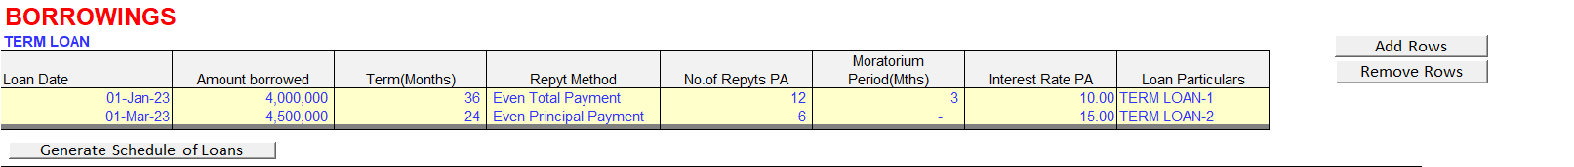
Input Sheet_Borrowings segment
The BORROWINGS module in the tool has one of the world’s most advanced loan modelling functions. A pioneering feature here is the auto-generation of loan repayment schedules for any number of loans the user may input into the tool and the auto-population of the workings (borrowings, repayments, interest computation) into all associated reports without any manual effort by the user whatsoever.
In the BORROWINGS segment, the user may enter data for any number of loans that the business is planning to borrow during the forecasting period, and the tool will automatically update the various reports with the interest, repayment and loan balances for the forecast period automatically.
Thus, the cash flow reports will show for each period amounts received as loan, re-payments on account of interest and principal separately.
Likewise, the Balance sheet will populate the amount of loans outstanding as at the end of each period, and the Income statement will likewise show the period-wise interest on loans. In case the user wishes so, they may click on Generate Schedule of Loans button, and the tool will automatically generate a detailed loan-schedule report of each individual loan entered by the user as a separate file which can be saved by the user.
In case the user has a cash credit / overdraft facility, they can enter the interest rate chargeable under the section Overdraft/Cash Credit. Interest is then automatically applied whenever the projected bank balance is overdrawn. This can be verified in the projected monthly cash flow report.

Slide 9
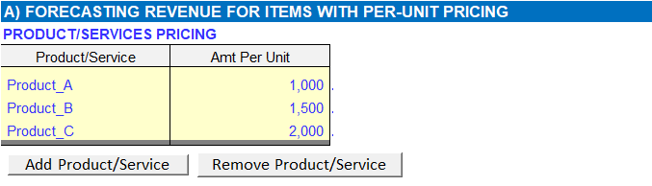
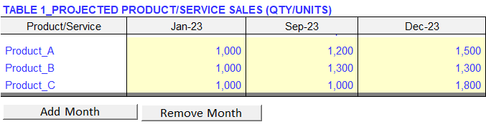
Input Sheet_Revenue segment
The tool allows a user to define an automated revenue model for any business type, be it manufacturing, trading, services (project-based , subscription-based) etc, or any mix of these models.
The revenue segment is divided into two, Part A and Part B. While Part A can be used for modelling revenue items with unit pricing , Part B can be used for modelling project-based revenue items. While using Part A, the user can add any number of products / services using the Add Product/Service button. After adding required rows for the products/services, the user then enters each product/service name along with its unit selling price
.
Once the products/services are defined with their unit prices, the user next proceeds to forecast the output or quantity for the products/services using two tables, namely, Table1 and Table2.
It may be noted here that the tool will automatically take the immediately preceding available monthly output data for months not explicitly defined by the user. For example, above, we have added only two columns for Sep-2023 and Dec-2023 in Table 1, since these are the months when a change in output is forecasted to happen. The intervening months between Jan-2023 and Sep-2023 will automatically take January’s output as their values, and so on.

Slide 10
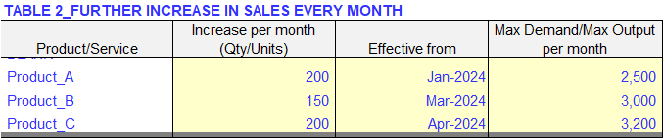
Input Sheet_Revenue segment
When a user is planning to prepare long-term budgets, it is not necessary to keep adding months in Table-1. The user can instead use Table-2 where they can set a model for adding output/quantity monthly beginning from a specific month defined in Table-2 product/service-wise. In the given example above, the tool has already forecasted sales till Dec-2023 for Product A. If the user believes that there will be a monthly increase in Product-A’s sales by 200 units effective from Jan-2024 , then they will enter 200 and Jan-2024 in columns C and D against Product-A in Table 2, as shown below.
The user can also fix a monthly maximum output ceiling for each product/service separately and the monthly output/sales will automatically stop incrementing beyond this limit (in our case, we can fix a monthly cap of 2,500 units for Product-A).
In the above example, Product A’s projected output/sales from January 2024 is incremented by 200 units every month till it reaches the monthly cap of 2,500 units in May-2024, beyond which the monthly output/sales will continue to remain at the capped units (Output computed by the tool is shown below).

Slide 11
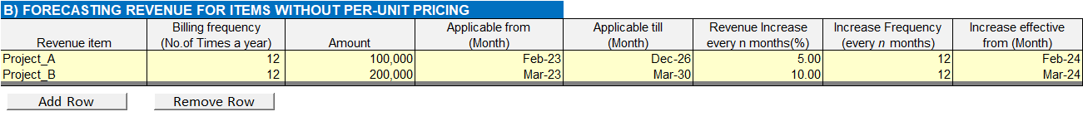
Input Sheet_Revenue segment
Part-B of Revenue segment is used for forecasting revenues for services/projects without unit pricing. As in Part-A, a user can add any number of rows for accommodating any number of services/projects in Part-B. This can be illustrated by means of an example below:
Output computed by the tool is shown below:

Slide 12
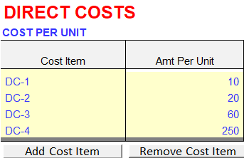
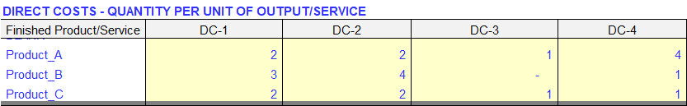
Input Sheet_Direct costs segment
Direct costs are automatically computed by means of highly advanced algorithms and the user is only required to define the direct cost items with their unit prices and express input-output relationship between the direct cost items and the products/services.The user can add any number of cost items with their respective unit costs using the Add Cost Item button.
For instance , we can assume that the business has four direct-cost items, say, Direct cost 1, Direct cost 2, Direct cost 3 and Direct cost 4, with their respective purchase costs as 10, 20, 60 and 250 per unit respectively.
Upon defining the direct cost items with their per unit rates, the user shall next proceed to enter values expressing the input-output relationship between the direct cost items and the finished products/services.In the given example, let us assume each unit of Product A requires 2 units each of Direct cost 1 and Direct cost 2, 1 unit of Direct cost 3 and 4 hours of Direct cost 4 (assuming Direct cost 4 is a direct labour cost). Likewise, for each unit of Product B, we can assume values of 3 units of Direct cost 1, 4 units of Direct cost 2 , 0 units of Direct cost 3 and 1 hour of Direct cost 4.

Slide 13
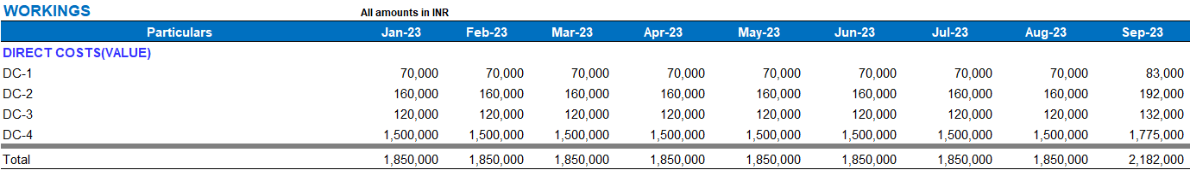
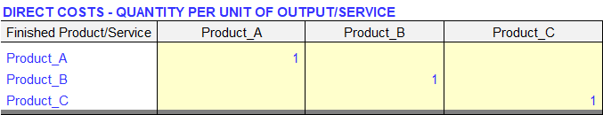
Direct costs workings
Upon entering the values as given above, the direct cost values are automatically computed by the tool by means of programmed functions, and the values can be viewed under Workings section below Projected Monthly Income Statement report sheet(extract shown below).
From the above example, it can be inferred that for traded products, since the direct cost and their corresponding output product/service items are one and the same, the value to be entered in the input-output relationship table shall be 1 in the cell the Direct cost and finished product items converge in the relationship table.
Example shown below (extract from Input Sheet):

Slide 14
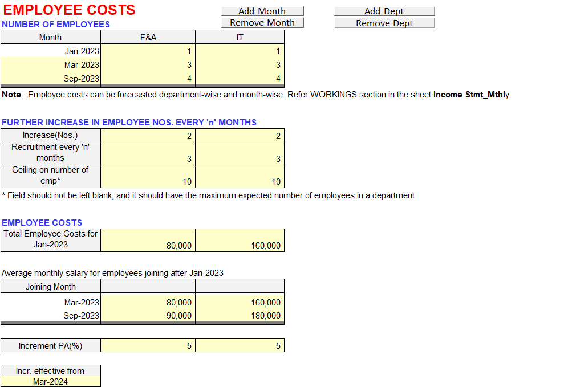
Input Sheet_Employee costs segment
A very unique feature of this tool is that a user can forecast/simulate employee costs by each department extremely accurately, with all the computations being fully automated.
The user can add any number of departments specific to their business using “Add Department” button.

Slide 15
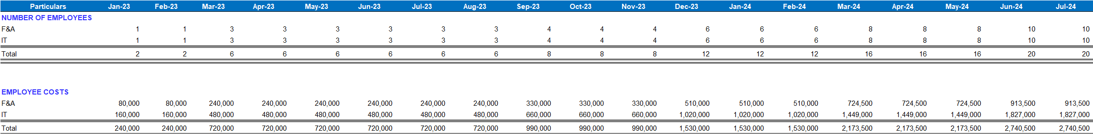
Employee costs workings
Based on the inputs entered by the user, the tool will automatically compute the employee costs (below extract taken from the Workings section under Projected Monthly Income Statement report sheet).
Note on the workings
Let us consider Dept F&A. The number of employees in Jan’23, that is the budget beginning month, in the Input Sheet (refer previous slide) is 1, with total employee costs in Jan’23 assumed at INR 80,000. The number of F&A employees is budgeted to increase to 3 employees in Mar’23. The average salary of employees joining in Mar’23 is assumed at INR 80,000 (say, one employee might be joining at a monthly salary of INR 30,000, while the 2nd employee might be joining at a monthly salary of INR 130,000, giving an average of INR 80,000 for the two employees joining in Mar’23, which needs to be entered in the Input Sheet). By this logic, we can infer that the F&A salary for Jan’23 and Feb’23 will be INR 80,000 (refer workings above) , while it will be INR 240,000 in March’2023 (which is INR 80,000 PLUS 2 new employees X INR 80,000, being the average monthly salary for the new joiners joining in Mar’23) and so on.
In the 2nd table , an increase of 2 employees every 3 months beginning after the last month entered in the 1st table, that is , Sep’23, is assumed. Thus, while the number of F&A employees in Sep’23 is 4, it will be 6 in Dec’23, 8 in Mar’24, and so on. These features allow for the most accurate financial modelling of employee costs.

Slide 16
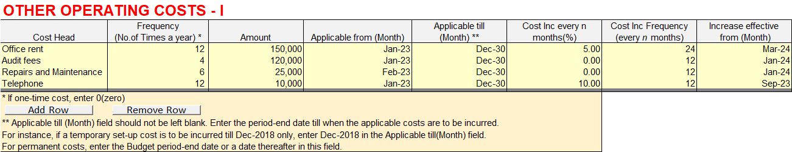
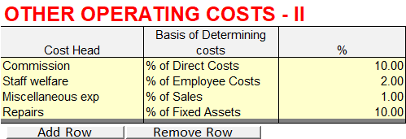
Input sheet_Operating costs segment
The user can model operating costs in two separate ways, depending on their behaviour, as shown below:
It will be noted that while a user can model those costs that change periodically (or do not change at all) in Table-1, they can model those costs that are pegged to an underlying variable (% of direct costs, % of employee costs etc) in Table-2.

Slide 17
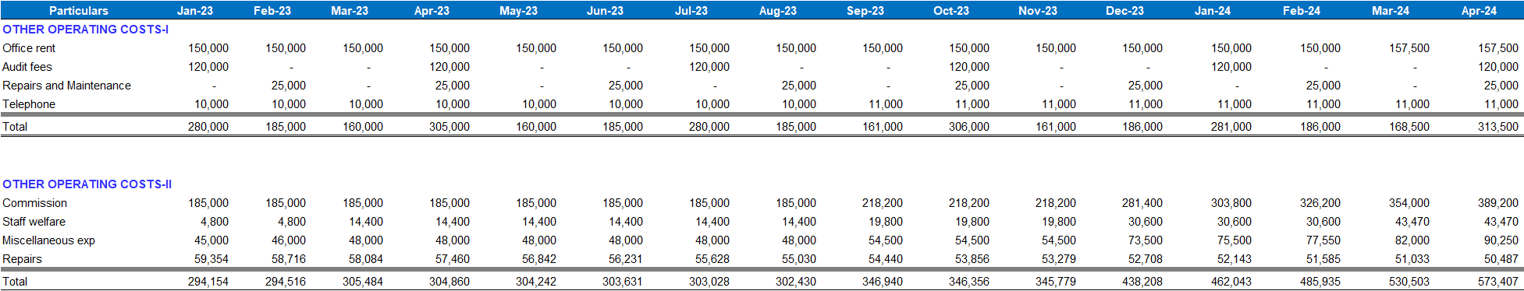
Operating costs workings
Based on the inputs entered by the user, the tool will automatically compute the operating costs (below extract taken from the Workings section under Projected Monthly Income Statement report sheet).

Slide 18
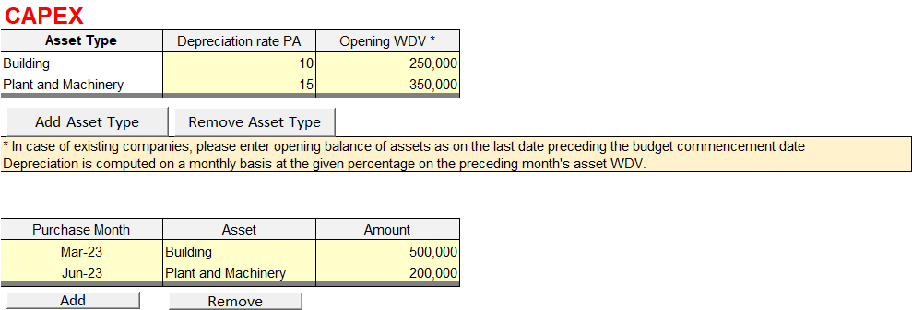
Input Sheet_CAPEX segment
Under CAPEX segment, the user can define any asset type/group, say, Building, Plant and Machinery, Office Equipment etc. along with their respective depreciation rates, and their opening balances (only applicable in case when the forecast/budget is prepared for an existing business). In the next table, the user can do the actual CAPEX budgeting, that is enter the expected month a particular asset is to be acquired and the amount of acquisition.
Upon doing so, all the relevant values will be accurately reflected in the respective reports (depreciation in the income statement, written down values in the Balance sheet and acquisition/disposal of CAPEX items in the cash flow reports).

Slide 19
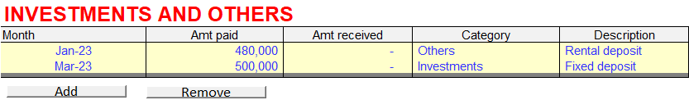
Input Sheet_Investments segment
For modelling investments, advances, deposits (like utilities deposit, rental deposits) and their redemptions, the user will use this segment.

Slide 20
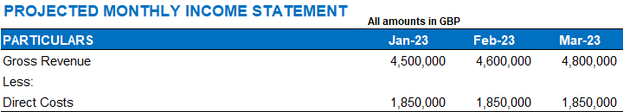
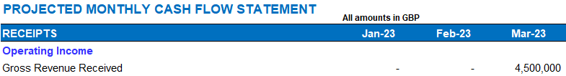
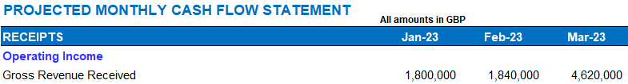
Input Sheet_Other assumptions segment
Under the Other Assumptions segment, the user will enter Average Collection Period (for determining receivables), Average Payment Period (for determining payables), Inventory Holding Period (for determining Inventory), Rate of Return PA (for computing interest on Investments), among others. Consider an average collection period of 59 days for Receivables, for example. In the given model, projected sales in Jan- 2023 is 4,500,000. Since the average collection period is 59 days, the sale will be realised only in Mar-2023 (Extract from Income statement and Cash flow report below):
We can now change the Cash/Credit sales split in the Input sheet (presently at 100% credit) to 40 % cash and 60% credit and assess the impact on the cash flows. Now, the sale realised in Jan-2023 will be 1,800,000 (40% being cash sales), while the sale realised in Mar-2023 will be 4,620,000, computed as 40% of Mar-2023 sales, equalling 1,920,000 (representing the cash component, realised in the month of sale itself) PLUS 60% of Jan-2023 sales, equalling 2,700,000(representing the credit component, realised 59 days after the month of sale, that is, Mar-2023).
A Similar logic is applied while determining monthly vendor payments, thus, allowing for cash flows to be modelled extremely accurately.

Slide 21
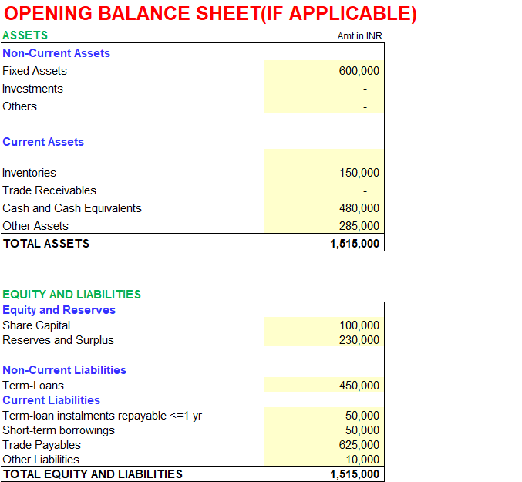
Input Sheet_Opening Balance sheet segment
This segment is applicable only for existing companies. The user shall enter opening balances prevailing on the date immediately preceding the budget beginning date.

Slide 22
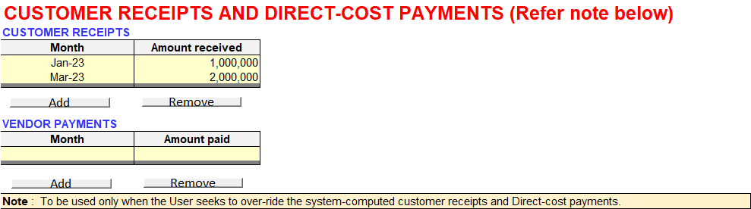

Input Sheet_Customer receipts and Direct-cost payments segment
In this segment, a user can override the system-computed customer receipts and vendor payments for any month or months.
Extract from the projected monthly cash flow report is shown below.

Slide 23
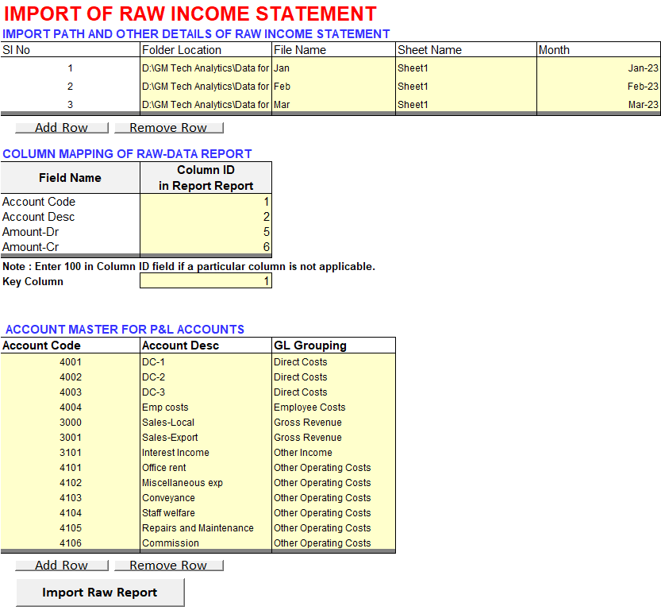
Input Sheet_Import of Actual Income Statement/Trial Balance segment
A very unique feature of the tool is a fully-automated budget Vs actuals P&L variance analysis report. The user can import raw P&L Trial Balance generated from any ERP/accounting software for any number of months in one-go without having to manually format the raw report before importing (like removal of report headers, re-alignment of columns etc). The user can then perform a detailed P&L variance analysis for any period with the aid of this report.
In the given example, the user is planning to do a variance analysis for Jan-2023 to Mar-2023, and accordingly, they enter the file particulars of the raw Trial Balance files (generated from the user’s ERP) which contain the data for the required months. The user then does a one-time column mapping and account master definition (the first time while using the tool) and then clicks on the Import Raw Report button.
The tool then proceeds to fetch data from each raw data file and gives a comprehensive Budget Vs Actuals P&L report month-by-month for easy analysis. As explained above, this is an entirely automated process from start to finish. The TB import functionality is explained in further detail in the next slide.

Slide 24
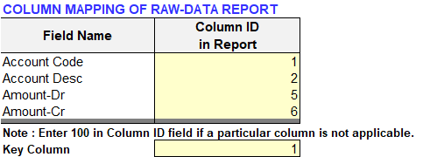
Input Sheet_Import of Actual Income Statement/Trial Balance segment
COLUMN MAPPING FUNCTIONALITY EXPLAINED IN DETAIL
There is a unique column mapping functionality in the tool by which the tool can automatically import relevant data from the raw report while leaving out redundant data like TB headers, footers, rows for totals, blank rows etc. In the given table in the Input sheet, the user needs to specify in which columns in the raw trial balance report (that is to be imported) the data for GL Account Code, GL Account Description, Amount-Dr and Amount-Cr are located. This is explained in further detail below:
Column Name | Description
Account Code | The column where GL account codes are located in the raw TB report shall be entered here in a numeric format (1 for Column A, 2 for Column B etc). In certain ERPs/Accounting S/W applications, there may not be an Account Code field in the raw TB report in which case, both the Account Code and Account Description fields in the table above shall be mapped to the Account Description columns in the raw TB report. For instance, if Account Description column is located in Column A in the raw TB report, both the Account Code and Account Description fields in the above mapping table shall have the values 1 (which corresponds to the alphabet A).
Account Description | The column where GL account descriptions (for instance, Conveyance A/c, Repairs and Maintenance Ac etc) are located in the raw TB report shall be entered here.
Amount-Dr | The column where the debit balances are located in the raw TB report shall be entered here.
Amount-Cr | The column where the credit balances are located in the raw TB report shall be entered here.

Slide 25
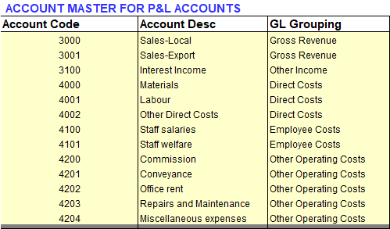
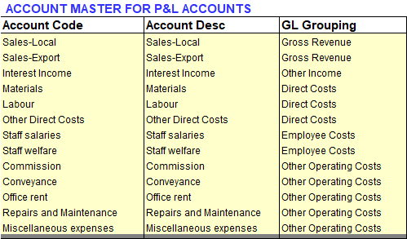
Input Sheet_Import of Actual Income Statement/Trial Balance segment
POPULATING THE P&L ACCOUNT MASTER TABLE
The user shall next populate the given table with the various P&L account heads (both the GL Account Code and Account Description of the P&L items shall be entered) and select each item’s GL grouping from the drop-down list (whether Revenue, Direct Cost, Employee Cost etc). This is to enable the tool to identify the revenue and cost-type GL accounts and import these for variance analysis while ignoring asset and liability-type account heads.
This is a one-time activity done at the time of setting up of the tool for variance analysis.
As explained in the previous slide, in certain ERPs/ accounting applications, there might not be an Account Code field in the raw Trial Balance report generated from the ERP/application.
In such cases, the GL Account Description shall serve as the look-up value for the tool and thus, GL Account Description shall be entered in both the Account Code and Account Description fields, as shown in the adjacent table.

Slide 26

Input Sheet_Reporting Currency Segment
In case the user wishes to present the reports in a different currency from the one they used for entering the inputs, that is, base currency, they can use this segment for changing the reporting currency to the desired one. Accordingly, the values in all the reports get converted into the reporting currency.

Slide 27
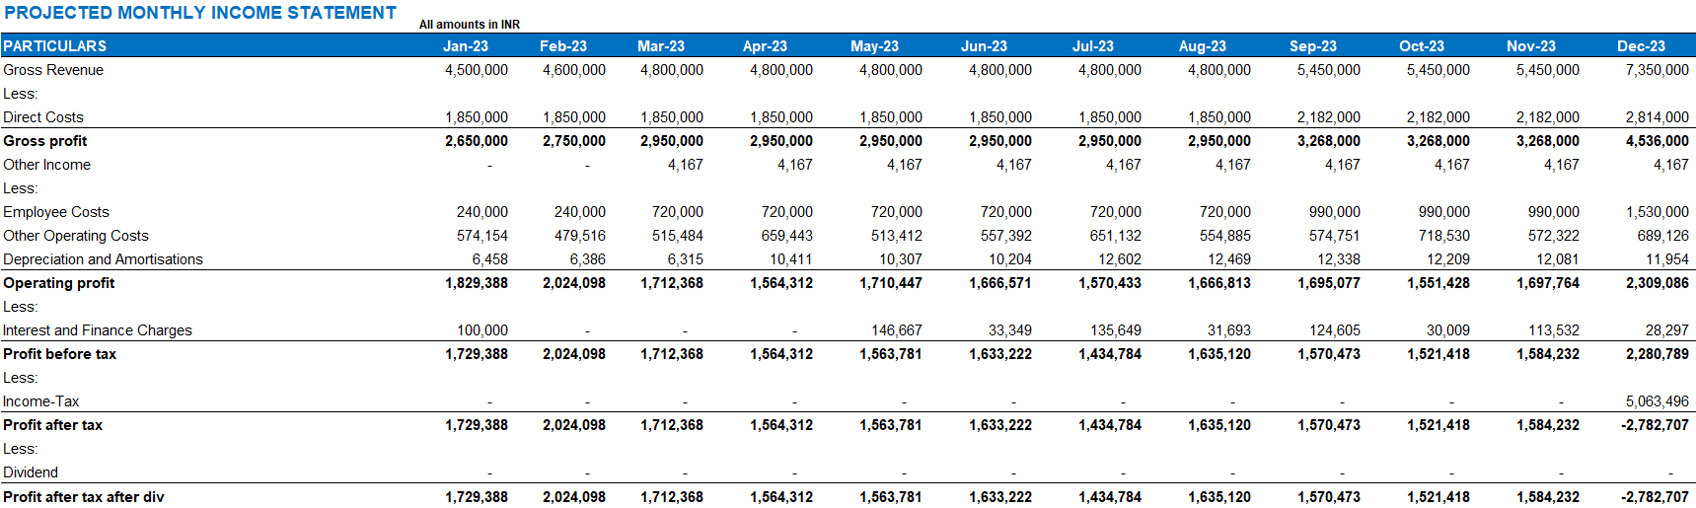
Screen-shots of Reports

Slide 28
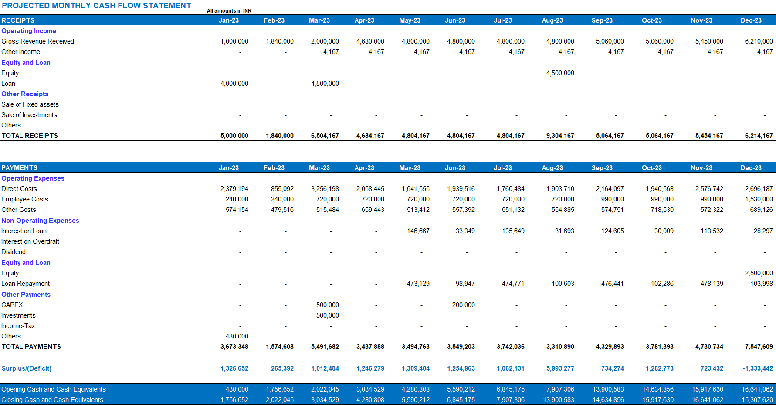
Screen-shots of Reports

Slide 29
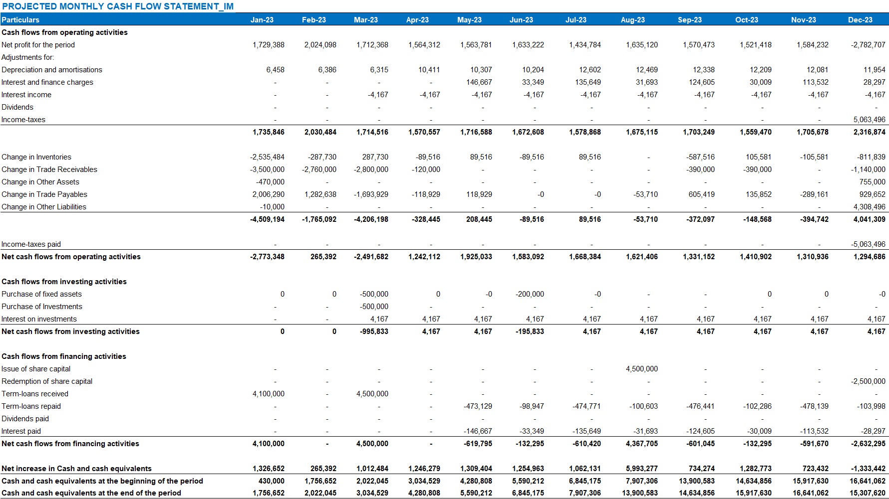
Screen-shots of Reports

Slide 30
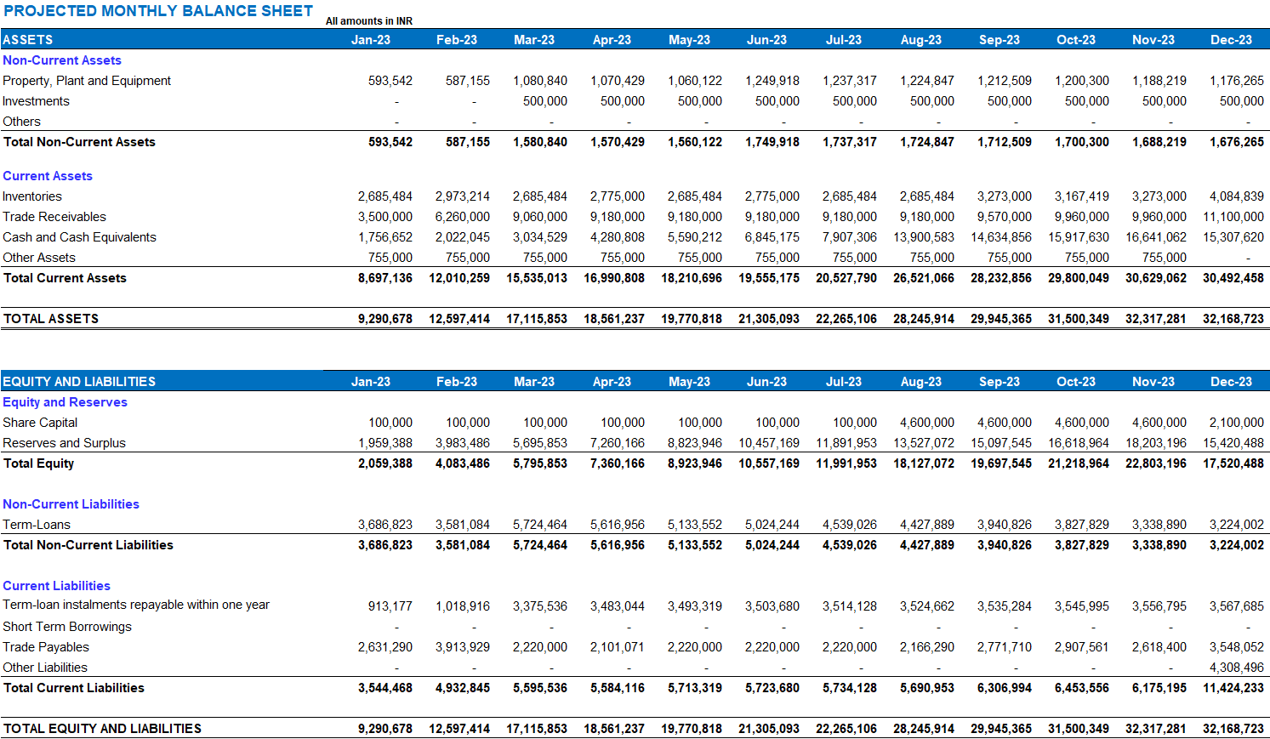
Screen-shots of Reports

Slide 31
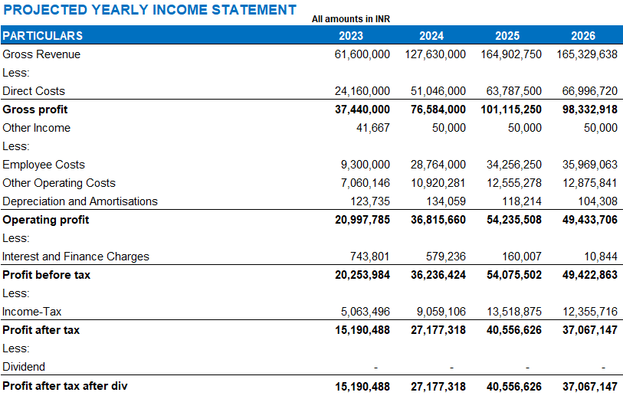
Screen-shots of Reports

Slide 32
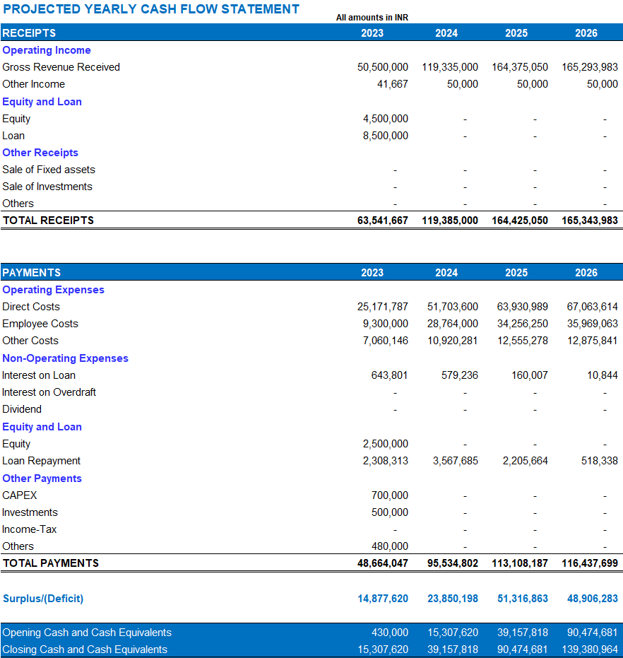
Screen-shots of Reports

Slide 33
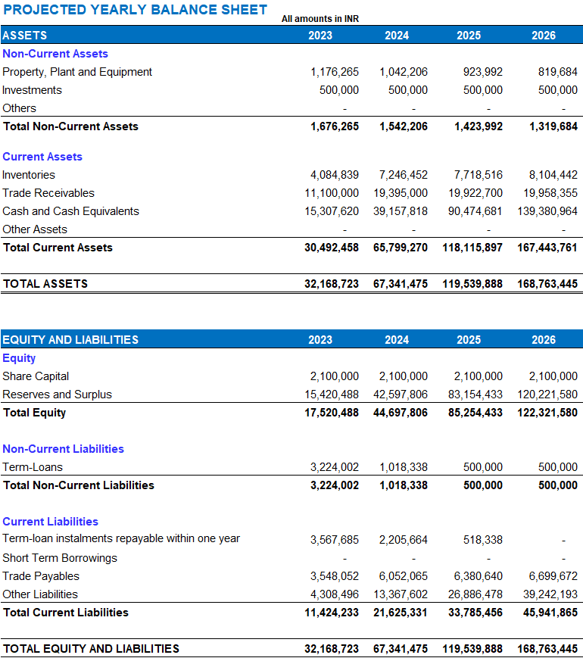
Screen-shots of Reports

Slide 34
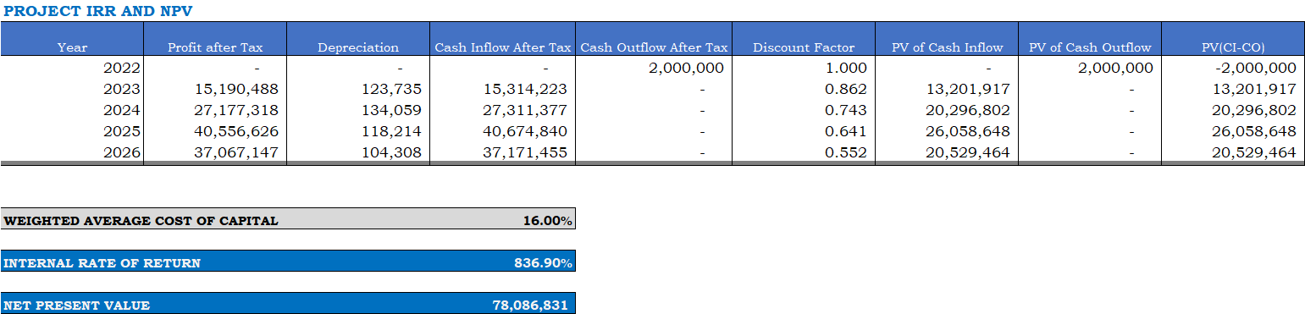
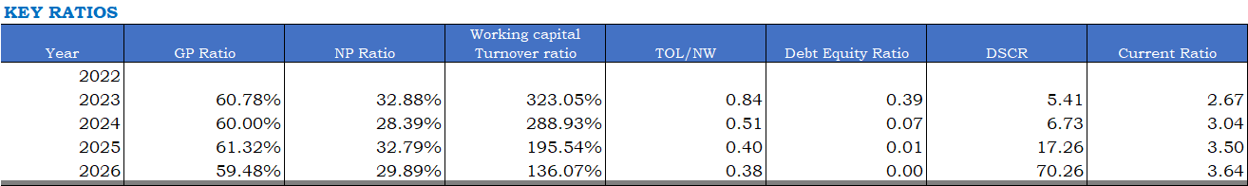
Screen-shots of Reports

Slide 35
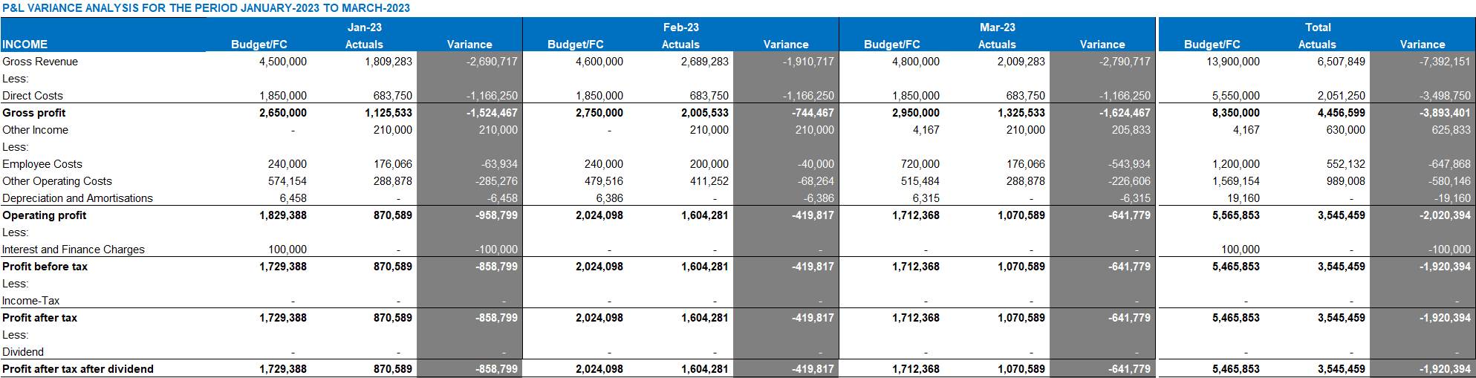
Screen-shots of Reports

Slide 36
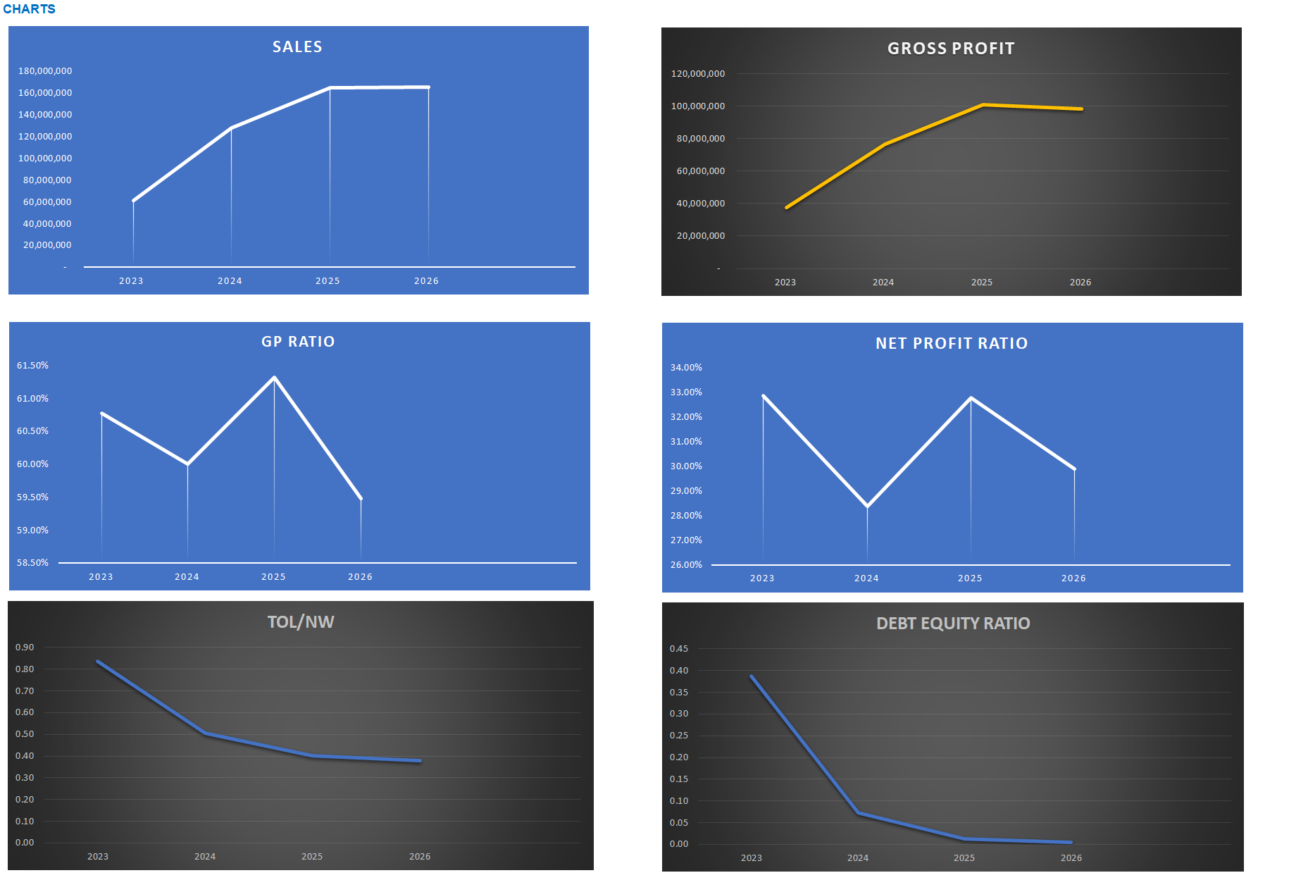
Screen-shots of Reports

Slide 37
In case you wish to buy a permanent license of the tool, contact GM Tech Analytics support@gmtechanalytics.com https://gmtechanalytics.co.in

