Slide 1
USER GUIDE JUST-IN-TIME MATERIAL MANAGEMENT TOOL

Slide 2
About the tool
The Excel-based Just-In-Time Material Management Tool is an advanced integrated material procurement planning, scheduling and control system for manufacturing companies, ensuring tremendous savings to a business by eliminating the need to maintain raw material levels beyond required levels , following the principles of Just-In-Time Inventory management.
Key features
Computes lowest possible raw material inventory levels for each item of raw material while ensuring their timely availability for production, thus offering twin benefits of lower inventory holding costs and elimination of stock-out situations.
Helps in release of much-needed cash into the business that would otherwise be locked by holding excess stocks
Optimal scheduling of ordering raw materials ensures ordering costs (transportation, handling charges etc) are kept to the minimum
Ensures inventory obsolesence is eliminated / kept to the bare minimum

Slide 3
Layout of the Tool
Just-In-Time Material Management Tool
Input Sheet
All user-inputs are to be entered in the Input Sheet
Reports
The reports will be auto-populated based on user-inputs in the Input sheet
Report_Material Planning
Report_Analytics
Report_PO Planning

Slide 4
Input Sheet
All the user-inputs are to be entered in the Input Sheet in the yellow-coloured cells, with all other cells protected from editing.
The Input Sheet is divided into various sections as given below:
Section | Description
Table A | The user can define the various finished products and their day-wise planned production in this section.
Table B | This section is the Raw material item master where the user can define various raw materials, their prices, lead-time for delivery, among other details
Table C | Here, the user will express the input-output relation between the raw-materials and the finished products (the number of units it takes for each raw material to manufacture/produce a finished product, or in other words, Bill of Material)
Table D | Here, the user will enter for each finished product the number of days the corresponding raw materials remain in production process. For example, if a Product A requires two materials X and Y, and X is inducted into production two days before Product A is produced, while Y is inducted the same day Product A is produced, the user will enter 2 corresponding to X and 0 corresponding to Y against Product A in this table.

Slide 5
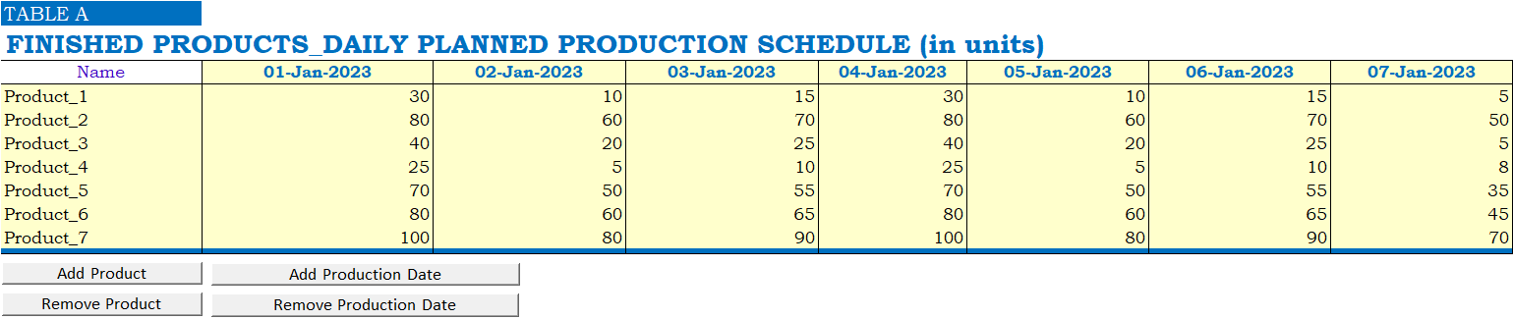
Input Sheet
In Table A of the Input sheet, the user can define the finished products and their day-wise planned production.
Products can be added/removed by means of the Add Product/Remove Product buttons. Production dates can be added or removed by means of the Add Production Date/Remove Production Date buttons.

Slide 6
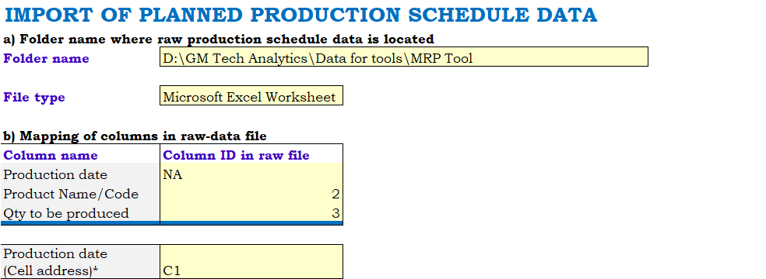
Input Sheet
If the user has day-wise planned production data in their ERP, the tool can automatically import these from the ERP reports and populate them into Table A without the user needing to manually format the raw ERP reports before importing.
 | The user will enter the folder path where the raw ERP reports containing the production data are saved The user will enter the type of raw report that is to be imported The user will do a one-time column and field mapping for retrieving the data from the raw report After doing so, the user shall click on the Import Raw Data button. Thereupon, the tool will fetch the production data from the raw report/reports and auto-populate these in Table-A of the Input Sheet. The tool can thus retrieve data from any number of raw-data files placed in the specified folder.

Slide 7
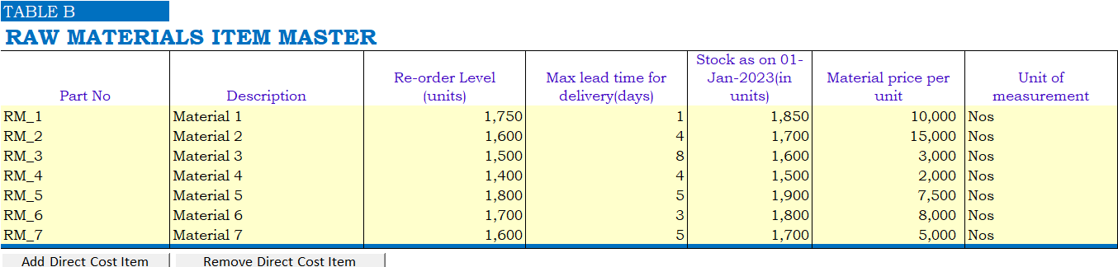
Input Sheet
Table B is the Raw Material Item Master where the user can add or remove different raw materials/consumables maintained by the company.
The user shall enter the Raw material code (if available), name, current re-order level*, maximum lead-time for delivery(in days), opening stock as on planning commencement date, cost per unit etc.
*The tool will compute the optimum re-order level for each item in the Report_Analytics sheet.

Slide 8
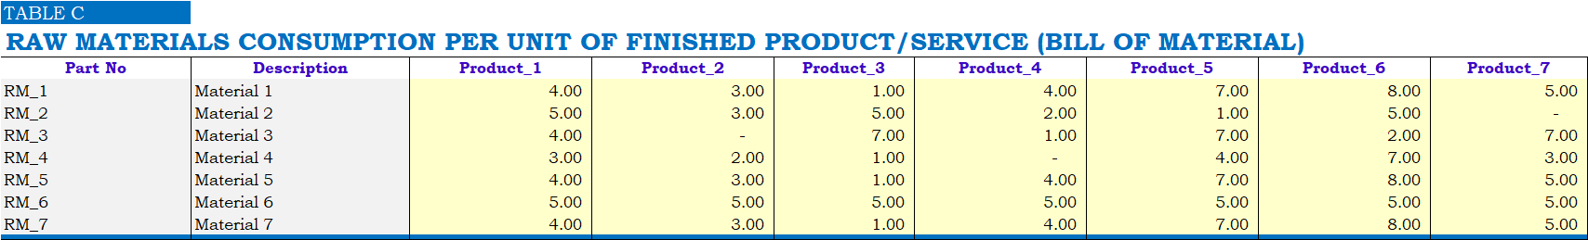
Input Sheet
In Table C, the user shall define standard consumption of each raw-material in units for manufacturing/producing a finished product (Bill of Material).

Slide 9
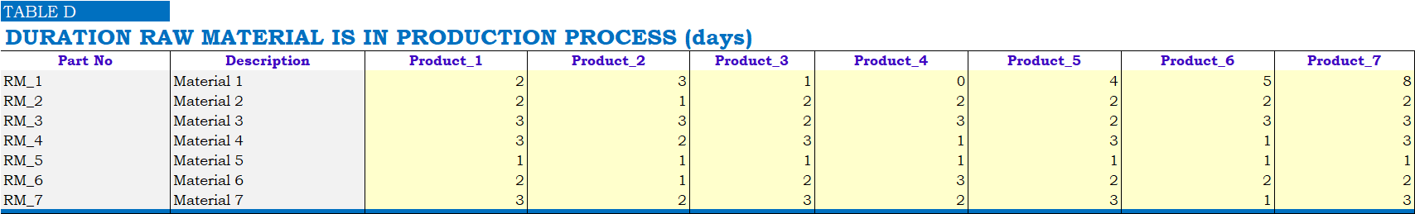
Input Sheet
In Table D, the user shall define the number of days each raw material is in production process for every finished product.
Interpreting data from the above table, RM_1 is issued for production/consumed 2 days before Product_1 is produced, 3 days before Product_2 is produced and so on. The tool will fetch data from this table and table-C to accurately compute the actual day-wise material consumption for any given production schedule.

Slide 10
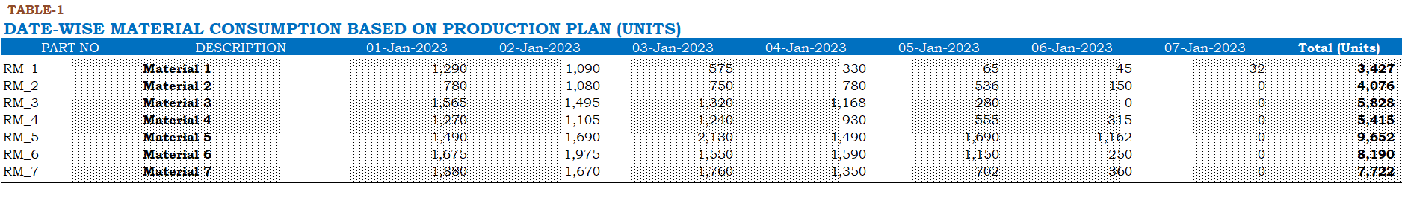
Report_Material Planning
Table-1 of this report shows the day-wise planned material consumption (in units) for each raw-material based on the production schedule and other data entered by the user in the Input sheet.

Slide 11
Report_Material Planning
We will explain by means of an example, how the material consumption figures in Table-1 are computed internally by the tool by means of a very advanced function.
RM-1 consumption for 01-Jan-2023 is 1,290units, as appearing in Table-1 in the previous slide.
The tool fetches material consumption details (for each unit of finished item produced) from Table C in Input Sheet(Bill of Material)
The tool fetches details of duration a material is in production process from Table D in Input sheet

Slide 12
Report_Material Planning
From Table-D extract in the previous slide, we can infer that RM_1 is consumed/issued for production 2 days before Product_1 is produced, 3 days before Product_2 is produced, 1 day before Product_3 is produced,, and so on.
Based on the above parameters, the tool , by means of an advanced function, determines RM_1 consumption for 1st January 2023 as 1,290 units, explained in detail below:
Product | RM_1 consumption days before production ( from Table-D) | Date of production for RM to be consumed on 1-Jan-2023 | Planned production for the given dates (from Table-A in Input sheet) | RM-1 consumption for each unit produced (taken from Table-C in Input sheet) | RM_1 consumption for 1-Jan-2023
Product_1 | 2 | 3-Jan-2023 | 15 | 4 | 4*15=60
Product_2 | 3 | 4-Jan-2023 | 80 | 3 | 80*3=240
Product_3 | 1 | 2-Jan-2023 | 20 | 1 | 20*,=20
Product_4 | 0 | 1-Jan-2023 | 25 | 4 | 25*4=100
Product_6 | 4 | 5-Jan-2023 | 50 | 7 | 50*7=350
Product_6 | 5 | 6-Jan-2023 | 65 | 8 | 65*8=520
Product_7 | 8 | 9-Jan-2023 | 0 (no production scheduled for 9-Jan-2023) | 5 | 0
Total |  |  |  |  | 1,290 units

Slide 13
Report_Material Planning
By means of the logic detailed in the previous slide, the tool proceeds to determine day-wise, the planned material consumption for each item.

Slide 14
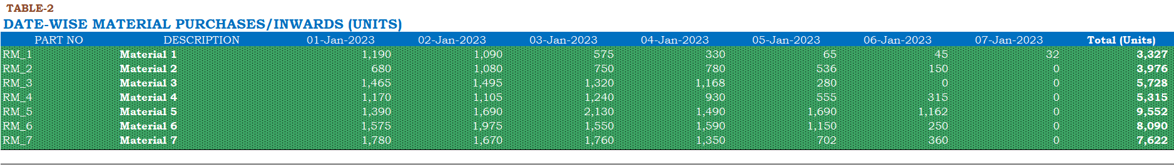
Report_Material Planning
Table-2 determines day-wise the quantities of various materials that need to be inwarded/received taking into account various factors like material consumption (from Table-1), re-order level entered by the user, available stock etc.

Slide 15
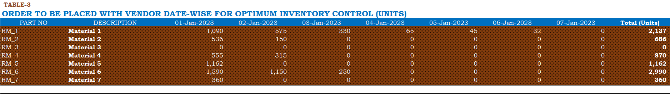
Report_Material Planning
Table-3 determines day-wise orders to be placed for various materials taking into consideration the lead-time for delivery, projected inwards (Table-2) and other factors.
This can be explained by taking RM_2 as example. The above table shows that 555 units of RM-4 need to be ordered on 1-Jan-2023. The tool determines this by fetching the data for lead-time for delivery from TABLE B in Input sheet ( which shows 4 days as the max. lead time for RM_4). Thus, for an inward of 555 units into factory store to happen on 5-Jan-2023, the order for 555 units needs to be placed on 1-Jan-2023 (4 days before 5-Jan-2023). If an order is placed earlier than 1-Jan-2023, it would result in extra inventory holding costs; if placed later than 4 days, it may result in stock-out and consequent stoppage in production.

Slide 16
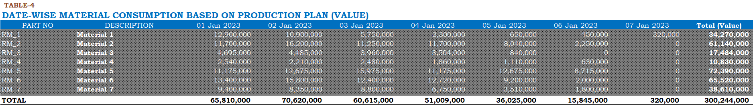
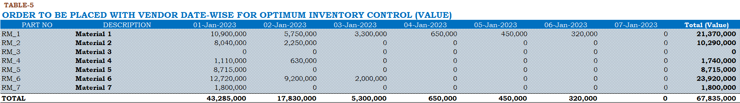
Report_Material Planning
Table-4 determines day-wise material consumption values.
Table-5 determines day-wise the value of purchase orders to be placed for timely inventory delivery.

Slide 17
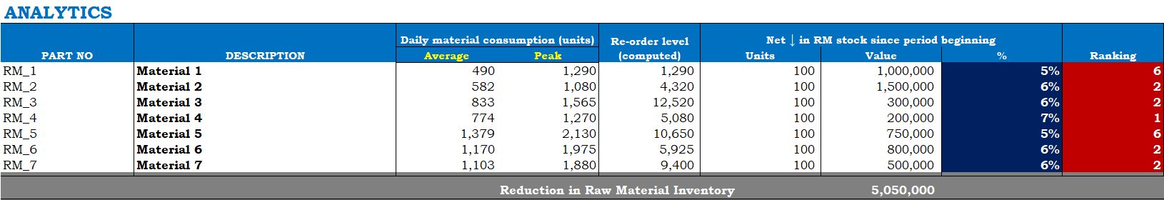
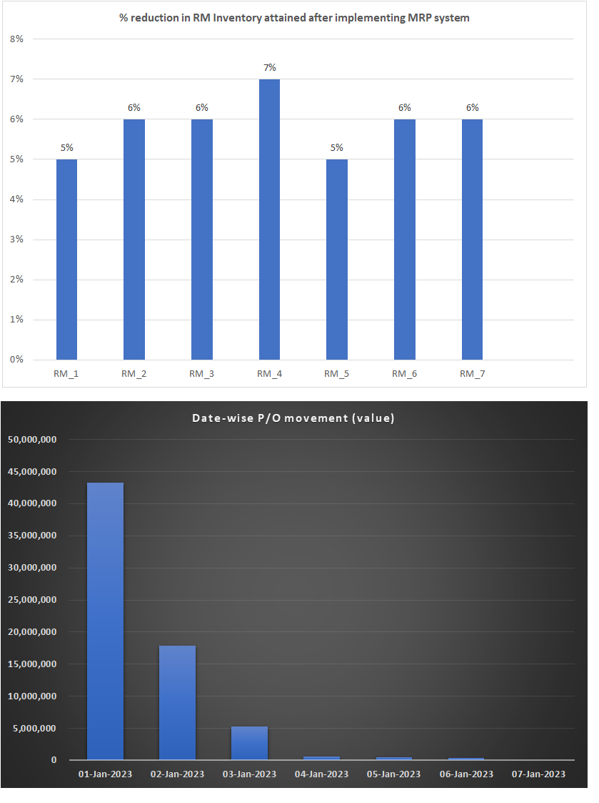
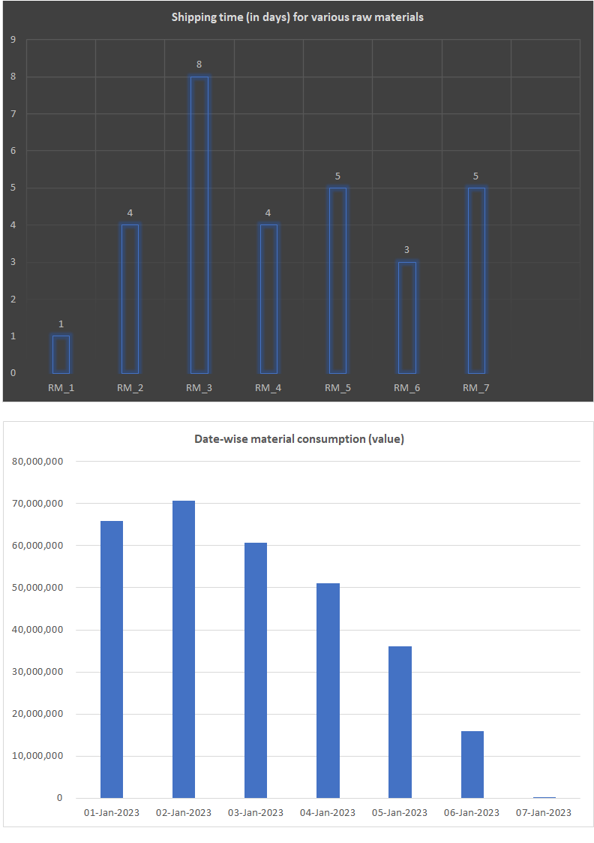
Report_Analytics
This report analyses determines key-material indices like item-wise average daily consumption, maximum daily consumption, Re-order level etc.

Slide 18
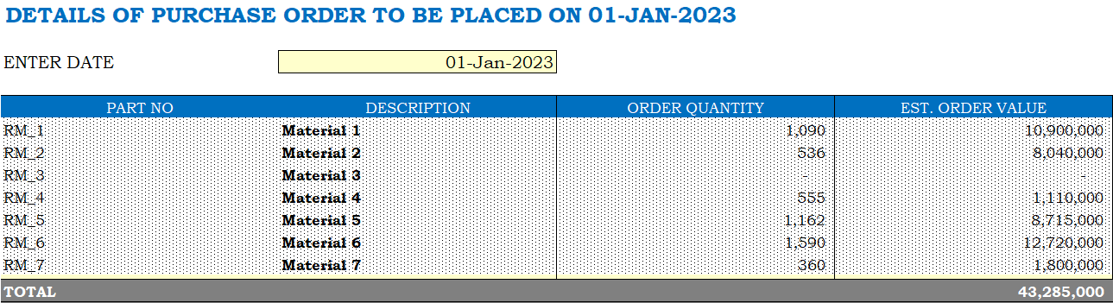
Report_PO Planning
This report estimates for each item the quantity and value of orders to be placed on vendors on a given date specified by the user.

Slide 19
For queries, contact GM Tech Analytics support@gmtechanalytics.com https://gmtechanalytics.co.in

